Slide 1

Reliance Cotton Spinning Mills Limited
Corporate Briefing Session 2025

Slide 2
Contents
Reliance Cotton Spinning Mills Limited (RCSML) Introduction
Strategic / Operational Developments
Historical Financial Highlights
Financial Results 2025
Future Outlook
Q & A Session

Slide 3
01
Reliance Cotton Spinning Mills Limited (RCSML) Introduction

Slide 4
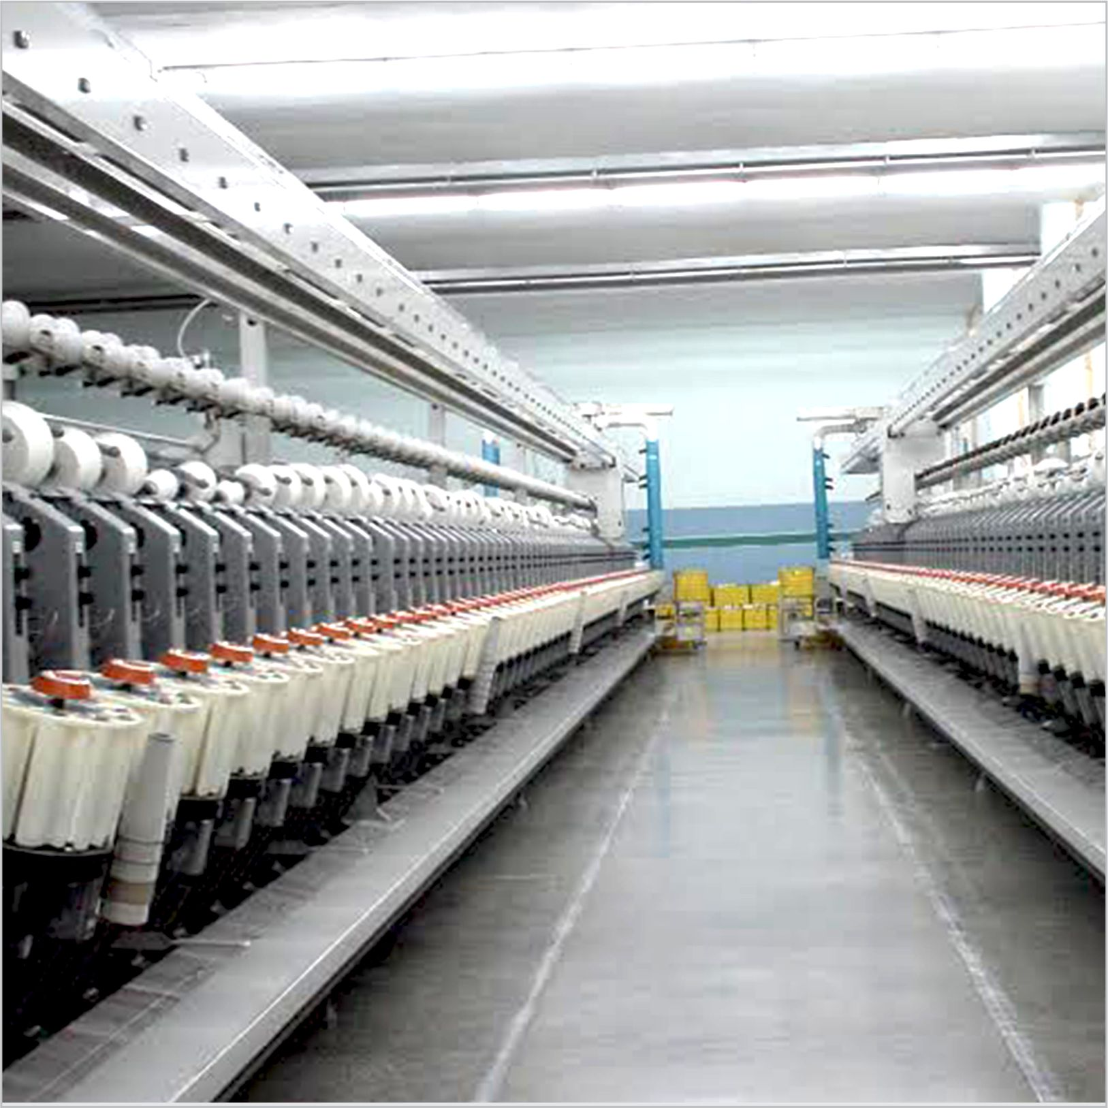
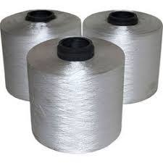
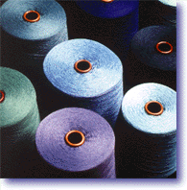



RCSML - Introduction
Reliance Cotton Spinning Mills Limited (RCSML) was incorporated in Pakistan on 13 June 1990 as a public limited company. The shares of the company are listed on Pakistan Stock Exchange. RCSML is principally engaged in manufacturing and sales of Cotton Yarn, PC Yarn and Mélange Yarn.
YARN
PC Yarn
Mélange Yarn
Total installed capacity of 59,232 Spindles (44,590,590 Lbs.)

Slide 5
02
Strategic / Operational Developments

Slide 6
Strategic / Operational Developments
The Company during the year has made investment in Plant & Machinery amounting to Rs. 577 million. The category of assets are as follows:
Cards
Semi Automatic Double Box Bales Pressing Machine
Air Compressor and Air Dryer
Ring Frames
- Over head blower for Ring Spinning Frames
- Bale Plucker
- Dust and Removal System for Back Process

Slide 7
03
Historical Financial Highlights

Slide 8
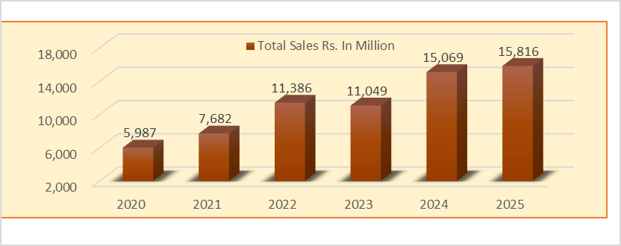
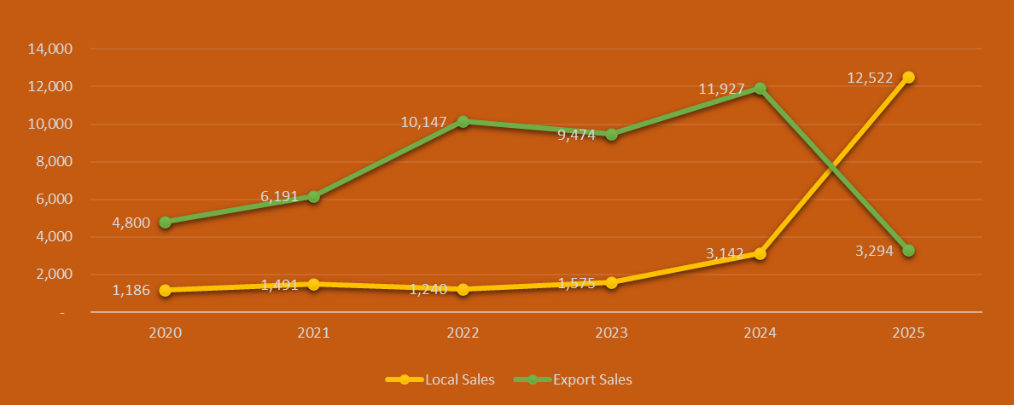

Slide 9
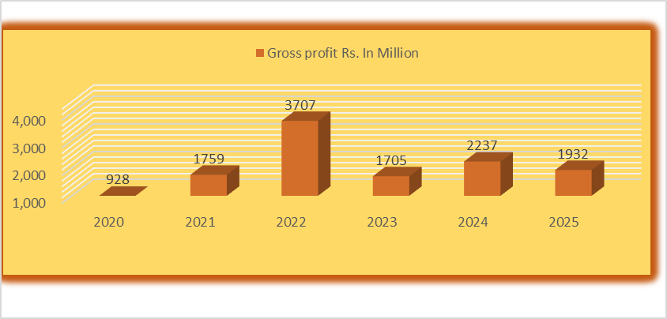
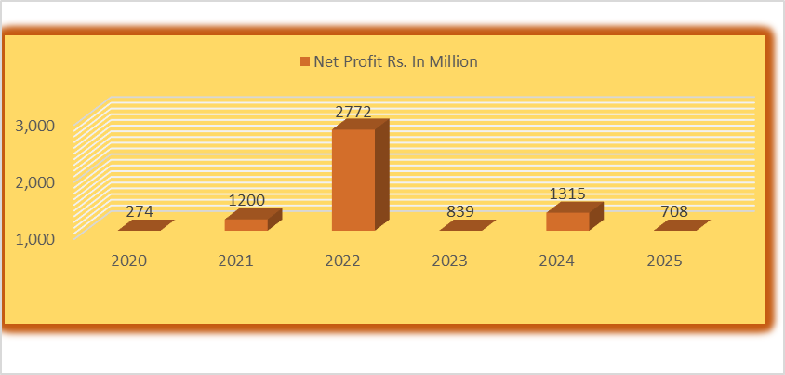

Slide 10
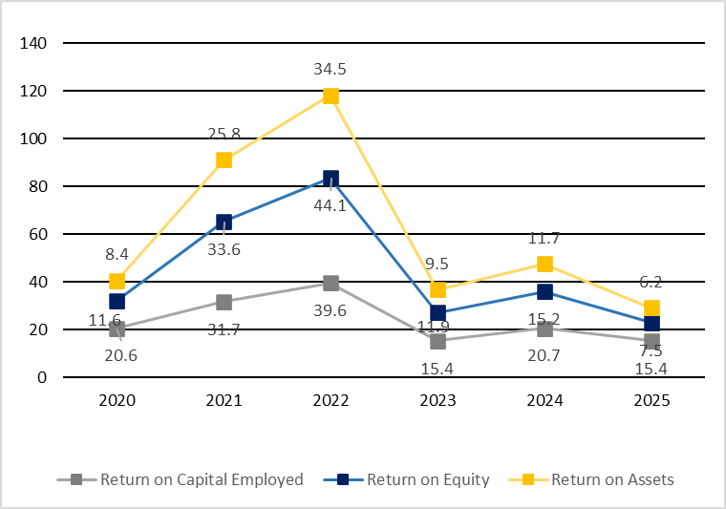
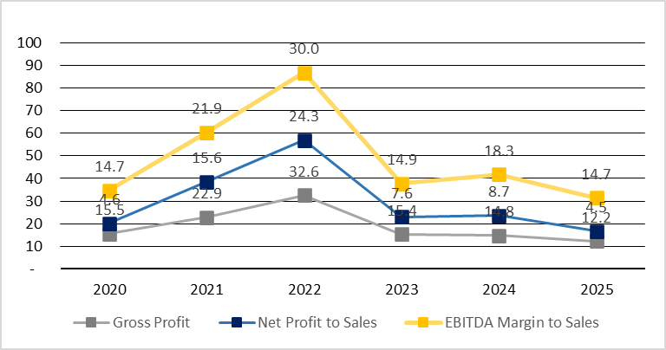

Slide 11
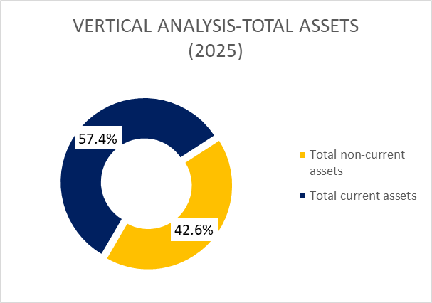
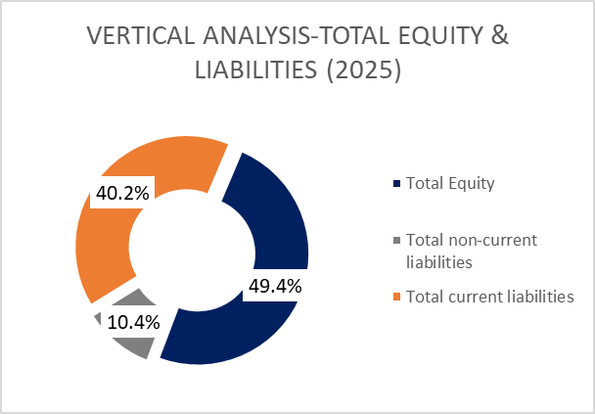

Slide 12
04
Financial Results 2025 vs 2024

Slide 13

Income Statement
4.96%
Sales Rs. 15,816 million (2024: Rs. 15,069 million)
-13.64
%
Gross Profit Rs.1,932 million (12.21% of sales) [2024: Rs.2,237 million (14.84% of sales)]
-46.2%
Net Profit Rs. 708 million (4.47% of sales) [2024: Rs. 1,315 million (8.72% of sales)]
+56%
Dividend paid Rs. 64 million (2024: 41 million)
+5%
Breakup value Rs. 881 (2024: Rs. 839) per share

Slide 14
Statement of value addition and its distribution
 | 2025 |  | 2024
 | Rs. (Millions) | %age | Rs. (Millions) | %age
Value addition
Sales | 15,816 | 96.55 | 15,069 | 95.95
Other income | 564 | 3.45 | 636 | 4.05
Total | 16,380 | 100.00 | 15,705 | 100.00
Value distribution
Cost of sales | 13,885 | 84.77 | 12,832 | 81.71
Distribution expense | 305 | 1.86 | 173 | 1.10
Administrative and other expenses | 445 | 2.72 | 369 | 2.35
Finance cost | 642 | 3.92 | 970 | 6.18
Income tax | 396 | 2.42 | 46 | 0.29
Dividend to shareholders | 64 | 0.25 | 41 | 0.26
Profit retained for future growth | 643 | 4.06 | 1,274 | 8.11
Total | 16,380 | 100.00 | 15,705 | 100.00

Slide 15
Balance Sheet Assets
18,998 million
2025
2024
17,724 million
5,568 million (29%)
Property, plant and equipment
6,502 million (37%)
2,693 million (14%)
Long term and short- term investments
1,255 million (7%)
5,633 million (30%)
Stores and stocks
6,105 million (34%)
2,062 million (11%)
Trade debts
2,196 million (12%)
547 million (3%)
Taxes refund due form Government
671 million (4%)
2,495 million (13%)
995 million (6%)
Other assets

Slide 16
Balance Sheet Equity &Liabilities
18,998 million
2025
2024
17,724 million
9,379 million (49%)
Shareholders Equity
8,631 million (49%)
2,368 million (12%)
Total Long-term liabilities
3,303 million (18%)
1,976 million (10%)
Trade Liabilities
1,577 million (9%)
4,676 million (25%)
Short Term Borrowings
3,497 million (20%)
518 million (3%)
Provision for Taxation
505 million (3%)
81 million (1%)
211 million (1%)
Other Liabilities

Slide 17
Consolidated Income Statement
 | 2025 | 2024
 | Rs. (Million) | Rs. (Million)
Sales | 17,836 | 15,069
Cost of sales | (15,640) | (12,832)
Gross profit | 2,196 | 2,237
Distribution cost | (310) | (173)
Administrative and other expenses | (519) | (370)
Other income | 492 | 654
Finance cost | (643) | (970)
Share of profit of associated companies | 2,664 | 349
Profit before taxation | 3,880 | 1,727
Taxation | (959) | (90)
Profit after taxation | 2,921 | 1,637
Value Distribution

Slide 18
Consolidated Balance Sheet - Assets
 | 2025 | 2024
 | Rs. (Million) | Rs. (Million)
Property, plant and equipment | 6,263 | 6,502
Long- and short-term investments | 8,019 | 3,602
Stores and stocks | 8,153 | 6,105
Trade debts | 2,063 | 2,196
Cash and banks | 758 | 270
Other assets | 1,991 | 1,217
Total | 27,247 | 19,892
Value Distribution

Slide 19
Consolidated Balance Sheet – Equity & liabilities
 | 2025 | 2024
 | Rs. (Million) | Rs. (Million)
Equity of parent shareholders | 14,727 | 10,730
Non-controlling interest | - | -
Long term liabilities | 3,067 | 3,363
Trade liabilities | 4,135 | 1,577
Short term borrowing | 4,676 | 3,497
Taxation | 561 | 513
Other liabilities | 81 | 212
Total | 27,247 | 19,892
Value Distribution

Slide 20
05
Future Outlook

Slide 21



Future Outlook
Pakistan’s economy commenced fiscal year 2025-26 on a positive trajectory, leveraging the improvements achieved in the preceding year. The stronger external and fiscal position provides a firm foundation for continued stability and growth.
A supportive global environment, coupled with stronger demand from trading partners and Pakistan’s recent trade deal with the United States, is expected to drive export growth. Concurrently, steady remittance inflows are expected to balance import pressures linked to tariff rationalization.
The Management remains dedicated to strengthening the Company’s future by driving innovation across our product portfolio and introducing new business segments. Strategic focus on enhancing operational efficiency and maintaining financial discipline will support these initiatives, enabling the Company to stay ahead of evolving market needs, and deliver sustained value to our shareholders.
.

Slide 22
06
Q & A Session

Slide 23
Thank You!

